Slide 1
Lecture_02

Slide 2
EXERCISE 15.1 Q.7,9
No. 7

Slide 3

PROBABILITY
Finding Probability : Complementary Events and Sum based on Marbles

Slide 4

Q. It is given that in a group of 3 students , the probability of 2 students not having the same birthday is 0.992. What is the probability that the 2 students have the same birthday?
Let P(E) be the probability of 2 students having the same birthday.
∴ P($\overline{E}$) is birthday.
∴ P($\overline{E}$) = 0.992
= 1
∴ P (E) = 1 –
= 1 – 0.992
= 0.008
Sol.
probability of 2 Students not having the same
0.992
Since 2 students having same birthday and 2 students not having same birthday are two complementary events
We know sum of probabilities of two complementary events is 1.
There are two events in this sum
2nd Event
1st Event
∴ Probability of 2 students having the same
birthday is 0.008

Slide 5


Q. A box contains 5 red marbles, 8 white marbles and 4 green marbles. One marble is taken out of the box at random. What is the probability that the marble taken out will be
(i) red ? (ii) white ? (iii) not green?
As the box contains 5 red marbles, 8 white marbles and 4
green marbles
Total no of possible outcomes =
(i) Let A be the event that a red marble is drawn
∴ No. of outcomes favourable to A = 5
Total number of marbles present in the box
How many red marbles are there?
Sol.
As the box contains
17
5 + 8 + 4
= 17
5
∴ P (A) =
$$5$$
$$17$$

Slide 6




Q. A box contains 5 red marbles, 8 white marbles and 4 green marbles. One marble is taken out of the box at random. What is the probability that the marble taken out will be
(i) red ? (ii) white ? (iii) not green?
Sol.
(ii) Let B be the event that a white marble is drawn
∴ No of outcomes favourable to B = 8
8
Not green means either it will be red or it can be white but it should not be green
∴ P (B) =
How many white marbles are there?
$$8$$
5 + 8 = 13
Total no. of. possible outcomes
Total no. of. possible outcomes
= 5
= 5
+ 8
+ 8
+ 4
+ 4
= 17
= 17
17
17
$$17$$
(iii) Let C be the event that the marble drawn is not green
∴ No of outcomes favourable to C = 13
13
∴ P (C) =
$$13$$
$$17$$

Slide 7
EXERCISE 15.1 Q.10
No. 8

Slide 8
PROBABILITY
Finding Probability : Sum based on Piggy Bank

Slide 9
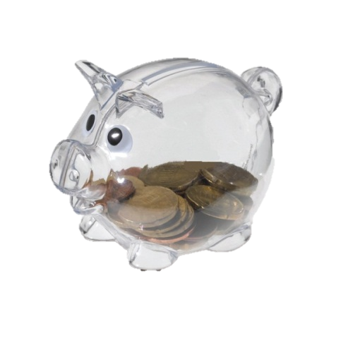
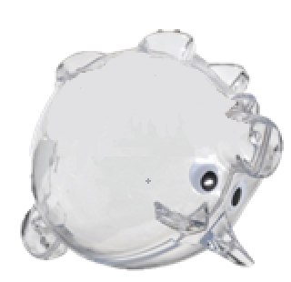

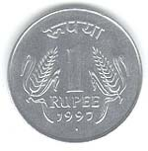

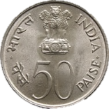
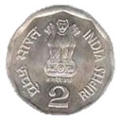
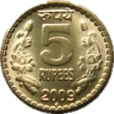



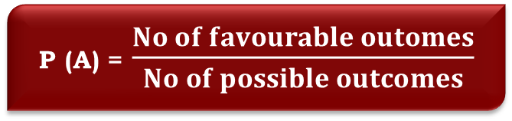


Q. A piggy bank contains hundred 50p coins, fifty Re 1 coins, twenty Rs 2 coins and ten Rs 5 coins. If it is equally likely that one of the coins will fall out when the bank is turned upside down, what is the probability that the coin
(i) will be a 50 p coin ? (ii) will not be a Rs 5 coin ?
A piggy bank contains
Fifty Re. 1 coins,
Twenty Rs. 2 coins
Total no. of coins in the piggy bank
Total no. of possible outcomes
(i) Let A be the event that the coin will be
a 50p coin
∴ No. of outcomes favorable to A =
Sol.
hundred 50p coins,
P (A) = $\frac{No of favourable outomes}{No of possible outcomes}$
and ten Rs. 5 coins.
Which coin will fall out ?
How many 50p coins are there
What is the formula for finding probability
= 100
+ 50
+ 20
+ 10
= 180
Total number of coins in the piggy bank
180
= 180
100
100
$$100$$
$$5$$
∴ P (A) =
$$=$$
$$180$$
$$9$$

Slide 10


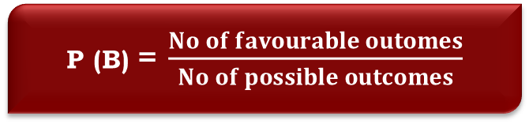



Q. A piggy bank contains hundred 50p coins, fifty Re 1 coins, twenty Rs 2 coins and ten Rs 5 coins. If it is equally likely that one of the coins will fall out when the bank is turned upside down, what is the probability that the coin
(i) will be a 50 p coin ? (ii) will not be a Rs 5 coin ?
Sol.
(ii) Let B be the event that it is not a Rs. 5 coin
∴ No. of outcomes favorable to B =
100 + 50 + 20
= 170
170
∴ P (B) =
Total no. of. possible outcomes
$$170$$
$$17$$
$$=$$
= 100
+ 50
+ 20
+ 10
180
= 180
180
$$180$$
$$18$$
Not a 5 Rs. coin means it will be either 50p or Rs. 1 or Rs. 2
P (B) = $\frac{No of favourable outomes}{No of possible outcomes}$

Slide 11
EXERCISE 15.1 Q.18
No. 9

Slide 12
PROBABILITY
Finding Probability : Sum based on Discs

Slide 13
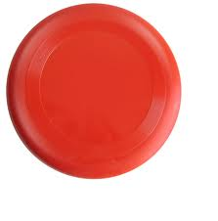


Q. A box contains 90 discs which are numbered from 1 to 90 . If 1
disc is drawn at random from the box , Find the probability that it bears
a two digit number (ii) a perfect square number
(iii) a number divisible by 5
Sol :
Outcomes
=
1,2,3,……..90
Total number of outcomes
=
90
1
2
3
………
90
Let A be the event disc drawn bears a two digit number
A
= 10,11,12, 13,……………90
No. of favourable outcomes =
90 - 9
= 81
No. of outcomes favourable to A
P(A) =
Total no. of outcome –
No. of outcomes in single digit
No. of all possible outcomes
∴ P(A) =
$$\frac{81}{90}$$
$$=\frac{9}{10}$$

Slide 14

Q. A box contains 90 discs which are numbered from 1 to 90 . If 1
disc is drawn at random from the box , Find the probability that it bears
a two digit number (ii) a perfect square number
(iii) a number divisible by 5
Sol :
(ii) A perfect square number
Let B be the event disc drawn bears a perfect square number
Outcomes favourable to B are
1,
4,
9,
16,
25,
36,
49,
64,
81.
No. of outcomes favorable to B = 9
1,
9,
1,
2,
3,
4,
5,
6,
7,
8,
9,
10
4,
No. of all possible outcomes =
11,
12,
13,
14,
15,
16,
16,
17,
18,
19,
20
90
21,
22,
23,
24,
25,
25,
26,
27,
28,
29,
30
No. of outcomes favorable to B
P(B) =
31,
32,
33,
34,
35,
36,
37,
38,
39,
40
36,
No. of all possible outcomes
41,
42,
43,
44,
45,
46,
47,
48,
49,
49,
50
P(B) =
51,
52,
53,
54,
55,
56,
57,
58,
59,
60
61,
62,
63,
64,
64,
65,
66,
67,
68,
69,
70
∴ P(B) =
71,
$$\frac{1}{10}$$
72,
73,
74,
75,
76,
77,
78,
79,
80
81,
82,
83,
84,
85,
86,
87,
88,
89,
90
81,

Slide 15

Q . A box contains 90 discs which are numbered from 1 to 90 . If 1
disc is drawn at random from the box , Find the probability that it bears
a two digit number (ii) a perfect square number
(iii) a number divisible by 5
Sol :
(iii) A number divisible by 5
Let C be the event disc drawn bears a number divisible by 5.
Outcomes favourable to C are
5,
10,
15,
20,
25,
30,
35,
40,
45,
50,
55,
60,
65,
70,
75,
80,
85,
90.
No. of outcomes favorable to C
1,
2,
3,
4,
5,
6,
7,
8,
=18
5,
9,
10
10
The number is divisible by 5 means the number is in 5’s table
No. of all possible outcomes = 90
11,
12,
13,
14,
15,
16,
17,
18,
19,
20
15,
20
No. of outcomes favorable to C
P(C) =
21,
22,
23,
24,
25,
26,
27,
28,
29,
30
25,
30
No. of all possible outcomes
31,
32,
33,
34,
35,
36,
37,
38,
39,
40
35,
40
41,
42,
43,
44,
45,
46,
47,
48,
49,
50
P(C) =
45,
50
51,
52,
53,
54,
55,
56,
57,
58,
59,
60
55,
60
61,
62,
63,
64,
65,
66,
67,
68,
69,
70
65,
70
∴ P(C) =
$$\frac{1}{5}$$
71,
72,
73,
74,
75,
76,
77,
78,
79,
80
75,
80
81,
82,
83,
84,
85,
90
85,
86,
87,
88,
89,
90

Slide 16
EXERCISE 15.1 Q.6,8
No. 10

Slide 17
PROBABILITY
Finding Probability : Sum based on Candies
: Sum based on balls

Slide 18
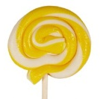







Q. A bag contains lemon flavoured candies only, Malini takes out one candy without looking into the bag. What is the probability that she takes out
(i) an orange flavoured candy?
(ii) a lemon flavoured candy?
Sol.
Let the number of of lemon flavoured candies be x.
∴ Total number of possible outcomes = x
Let A be event that the candy taken out is orange flavoured candy
Numbers of outcomes favourable to A = 0
$$0$$
∴ P (A) =
Does the bag contain any orange flavoured candy ?
$$0$$
x
$$=$$
How many lemon flavoured candies are there ?
NO
Let B be the event that the candy taken out is lemon flavoured.
Numbers of outcomes favourable to B = x
$$x$$
∴ P (B) =
$$1$$
$$=$$
$$\text{x}$$

Slide 19





Q. A bag contains 3 red balls and 5 black balls. A ball is drawn at random from the bag. What is the probability that the ball drawn is (i) red? (ii) not red?
Sol.
A bag contains 3 red ball and 5 black balls.
Total no. of possible outcomes = 8
Let A be the event that the ball drawn is red.
No of outcomes favourable to A =
$$3$$
If the ball drawn is not red then it will be which colour ball
How many black balls are there ?
How many red balls are there ?
There are two colour balls
$$3$$
∴ P (A) =
$$\text{8}$$
Let B be the event that the ball drawn is not red.
No of outcomes favourable to B = 5
$$5$$
∴ P (B) =
$$\text{8}$$

Slide 20
EXERCISE 15.1 Q.12
No. 11

Slide 21
PROBABILITY
Finding Probability : Sum based on Game of Chance

Slide 22



Q. A game of chance consists of spinning an arrow which comes to rest pointing at one of the numbers 1, 2, 3, 4, 5, 6, 7, 8 and these are equally likely outcomes. What is the probability that it will point at
(i) 8 ?
(ii) an odd number ?
(iii) a number greater than 2 ?
(iv) a number less than 9 ?
All possible outcomes are 1, 2, 3, 4, 5, 6, 7, 8
∴ Total no. of possible outcomes =
(i) Let A be the event that the number is 8
Outcome favourable to A is 8
∴ No. of outcomes favourable to A =
(ii) Let B be the event that it is an odd number
Outcomes favourable to B are 1, 3, 5, 7
∴ No. of outcomes favourable to B =
8
1
7
2
Sol.
8
6
3
5
4
1
= $\frac{1}{8}$
∴ P (A)
On whichever number the arrow points that number is taken as an outcome of that experiment
4
= $\frac{4}{8}$
∴ P (B)
$$\text{= }\frac{1}{2}$$

Slide 23




Q. A game of chance consists of spinning an arrow which comes to rest pointing at one of the numbers 1, 2, 3, 4, 5, 6, 7, 8 and these are equally likely outcomes. What is the probability that it will point at
(i) 8 ?
(ii) an odd number ?
(iii) a number greater than 2 ?
(iv) a number less than 9 ?
8
1
(iii) Let C be the event that the number is greater than 2
Outcome favourable to C are 3, 4, 5, 6, 7, 8
∴ No. of outcomes favourable to C =
(iv) Let D be the event that the number is less than 9
Outcomes favourable to D are 1, 2, 3, 4, 5, 6, 7, 8
∴ No. of outcomes favourable to D =
7
2
Sol.
6
3
6
5
4
∴ P (C)
= $\frac{6}{8}$
$$\text{= }\frac{3}{4}$$
8
∴ P (D)
= $\frac{8}{8}$
$$\text{= }1$$

Slide 24
EXERCISE 15.1 Q.13,19
No. 12

Slide 25
PROBABILTY
Finding Probability : Sum based on Number Die
Sum based on alphabet Die

Slide 26




Q. A die is thrown once. Find the probability of getting
(i) a prime number ; (ii) a number lying between 2 and 6;
(iii) an odd number.
All the possible outcomes are 1, 2, 3, 4, 5, 6
Total no. of possible outcomes =
(ii) Let A be the event of getting a prime number
Outcomes favourable to A are 2, 3, 5
∴ No. of outcomes favourable to A =
(ii) Let B be the event of getting a number lying between 2 and 6
Outcomes favourable to B are 3, 4, 5
∴ No. of outcomes favourable to B =
Sol.
6
6
6
6
3
3
$$3$$
$$1$$
∴ P (A) =
$$=$$
$$6$$
$$2$$
3
3
$$3$$
$$1$$
(iii) Let C be the event of getting an odd number
∴ P (B) =
$$=$$
Outcomes favourable to C are 1, 3, 5
$$6$$
$$2$$
∴ No. of outcomes favourable to C =
3
3
$$3$$
$$1$$
∴ P (C) =
$$=$$
$$6$$
$$2$$

Slide 27
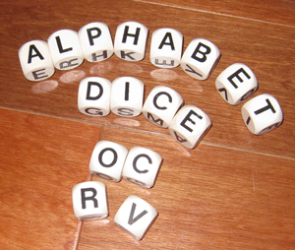



Q. A child has a die whose six faces show the letters as given below
The die is thrown once. What is the probability of getting
(i) A? (ii) D ?
All possible outcomes are A, B, C, D, E, A
Total no. of possible outcomes =
(i) Let A be the event of getting ‘A’
∴ No. of outcomes favourable to A =
A
B
C
D
E
A
Sol.
Have you ever seen a die with an alphabet ?
6
2
∴ P (A) =
$$\frac{2}{6}$$
$$\text{= }\frac{1}{3}$$
(ii) Let B be the event of getting D
∴ No. of outcomes favourable to B =
1
= $\frac{1}{6}$
∴ P (B)

Slide 28
Thank You

